Slide 1
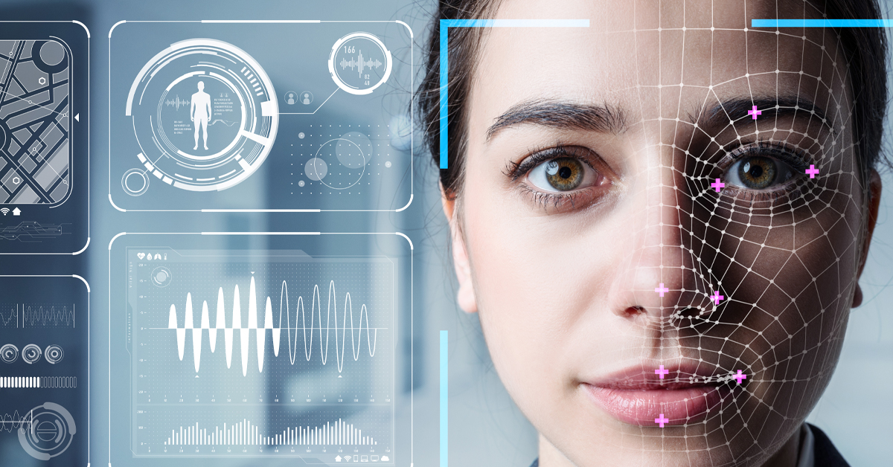
Face detection system
Team members:-
Arnav sharma
Hardik garg
Kuber dhaka
Lakshay tyagi
Amresh prajapati
Ansh Aggarwal

Slide 2
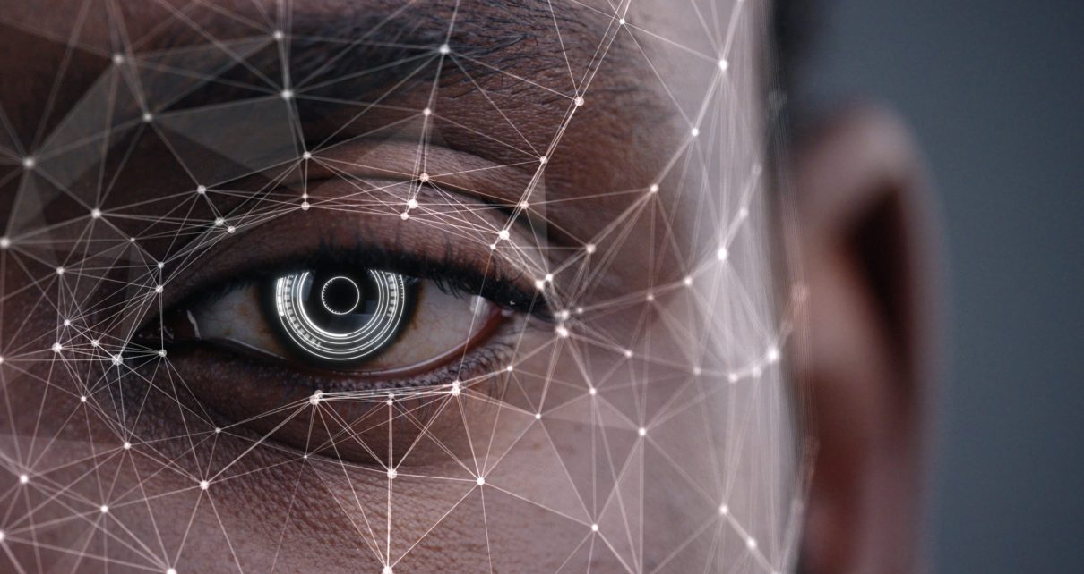

Introduction to face detection
Face detection is a computer technology that identifies human faces in digital images or videos.
It is a critical component of many applications, including facial recognition, security systems, and augmented reality.
The technology has made significant advancements in recent years, with increasing accuracy and performance metrics.

Slide 3
Python Libraries for Face Detection
OpenCV
OpenCV is a popular open-source library for computer vision and image processing.
Face Recognition
Face Recognition is a Python library built on top of dlib that provides face recognition capabilities.
NumPY
NumPy is a python library used for working with array.

Slide 4
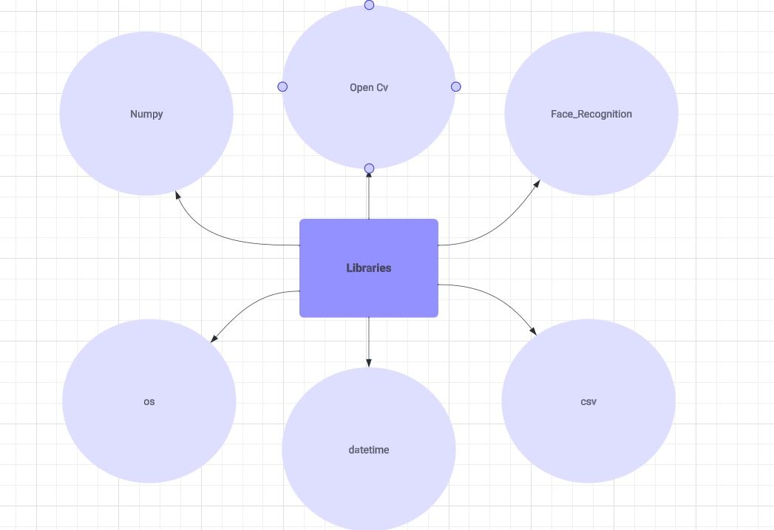

Slide 5
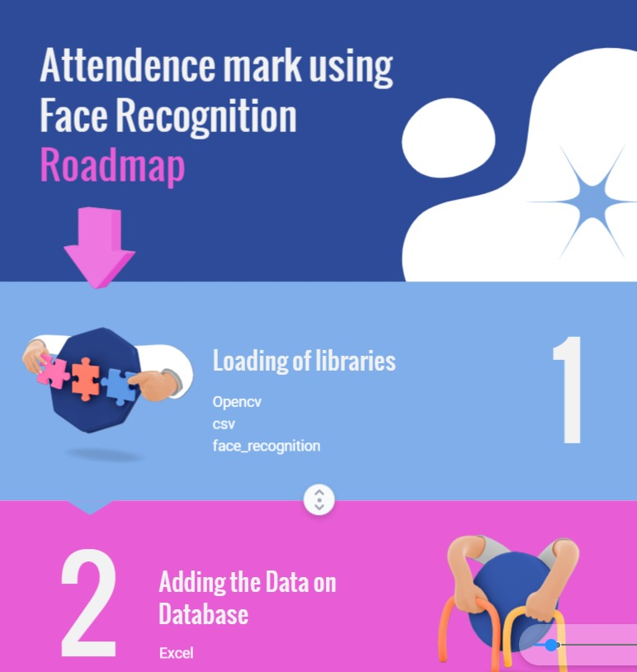

Slide 6


Slide 7
CHALLENGES IN FACE DETECTION
Variations in Facial Features
Privacy Concerns
Bias and Inaccuracy

